Slide 1

People that Deliver:
Indonesia’s Approach to Strengthen Supply Chain Management in the public health system
Ministry of Health
Republic of Indonesia
Mr. Bayu Tedja Mulya , Ministry of Health
February 2014

Slide 2
Purpose of presentation:
To share how the Ministry of Health in Indonesia is designing and implementing the work of “ People that Deliver” to improve supply chain management .
Notes:
This presentation is about how the Ministry of Health is using the global People that Deliver initiative to improve supply chain management within the Ministry of Health.

Slide 3
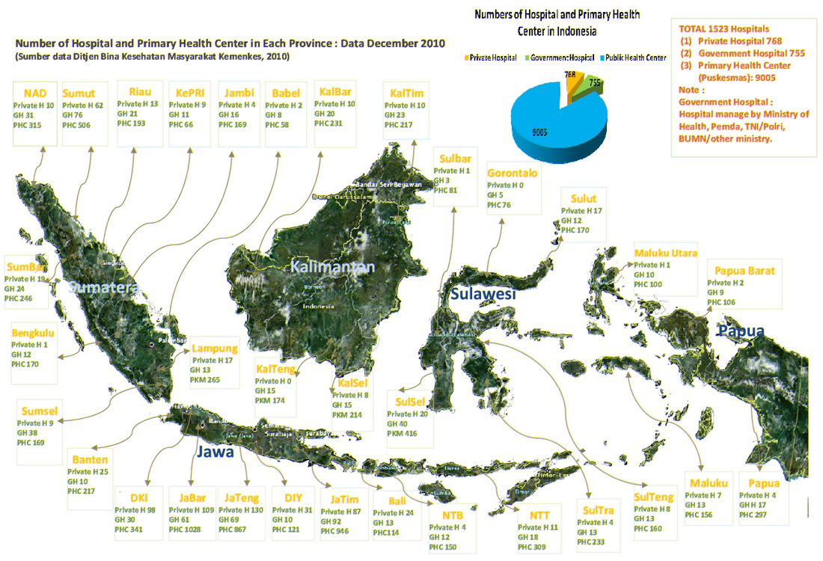
Notes:
Supply chain management is a top priority for Indonesia because of the massive scale of a national public health system. Serving 240 million people spread across a wide archipelago in 33 provinces and 497 districts is a major challenge for public health programs. Indonesia has 1,525 hospitals and 9,005 primary health centers.

Slide 4
Service Delivery Challenges
POLITICS
  Transition to decentralization and regional autonomy
  Coordinating who is responsible
  Implementing policies set at the central level in the field
PLACE
  Geographic complexity of over 17,000 islands
  Distance and transport infrastructure challenges
  Difficult to gain visibility into supply and demand information in the field
POPULATION
  Meeting the needs of 240 million people
  Isolated populations concentrated in difficult to reach areas
PROGRAMS
  Lack of priority put on supply chain management
  Qualified human resources in supply chain
  Coordination of domestic and external donor budgets
  Management of international and local suppliers
  Frequent stock outs
Notes:
The challenges we face in Indonesia can be described in four Ps: Politics, Place, Population, and Programs.
In politics, over the last decade Indonesia has gone through a major decentralization of political power, providing regional autonomy to the health sector. While this promotes local empowerment and decision-making, defining roles and responsibilities for public health interventions can be a challenge.
In terms of place, Indonesia’s geographic complexity requires us to overcome challenges in the flow of goods and access to supply and demand information.
For population, it is difficult to meet the needs of 240 million people, and due to the challenges of place, there are isolated populations concentrated in difficult to reach areas.
The impact on programs is that it is difficult to find adequate human resources to address these challenges, particularly in hard-to-reach areas. Supply chain management has not always been a program priority, and the coordination effort required to manage domestic and external budgets as well as international and local suppliers have proven very challenging.

Slide 5
Supply Chain Design
Historically, the source of funding has been the determining factor for how a commodity supply chain is designed.
  Central Government Budget
  Donors to Central Government (Global Fund, GAVI, USAID, JICA, AusAID)
  Need partnership between Pharamacy, Program, and partners to manage drugs in an appropriate manner.
5
Notes:
Currently there are several supply chain systems working at MOH that work in parallel to ensure that health commodities are available when they are required. The path that a commodity will take to make it to patients often depends on the source of funding, resulting in parallel and overlapping systems.
That’s why we need a partnership between the pharmacy group, the programs, and other partners.

Slide 6
Responsibilities in Supply Chain
Source of Fund / Task | Cental Gov Budget | Donor at Central Level | Provincial Gov Budget
Product selection | Program Units, Provincial Health Office (PHO) | Program Units | PHO
Quantification | Pharmaceutical Dir General (PDG), Program Units, PHO, DHO | Program Units, PHO | PHO
Supply Planning | Program Units, PHO, DHO | Program Units, PHO | PHO
Procurement | PDG | Program Units – Procurement Agent | PHO
Warehousing | PDG , Suppliers, PHO, DHO | Program Units – Owned WH, 3PL, PHO | PHO, Suppliers, DHO
Transportation/ Distribution | PDG , Suppliers, PHO, DHO | Program Units – Owned fleet, 3PL, PHO | PHO, Suppliers, DHO
Storage/ Inventory Management | PDG , PHO, DHO , Suppliers | Program Units, PHO | PHO
Routine Monitoring & Periodic Evaluation of SCM operations | PDG, PHO, DHO | Program Units, PHO | PHO
Notes:
Furthermore, responsibilities within the supply chain for various functions also depends on the source of funding. Most of the time, in programs funded by external donors, the individual program units have their own supply chain teams, rather than having it managed by the Pharmaceutical Directorate General, which has the main responsibility for supply chain management within the Ministry of Health.

Slide 7
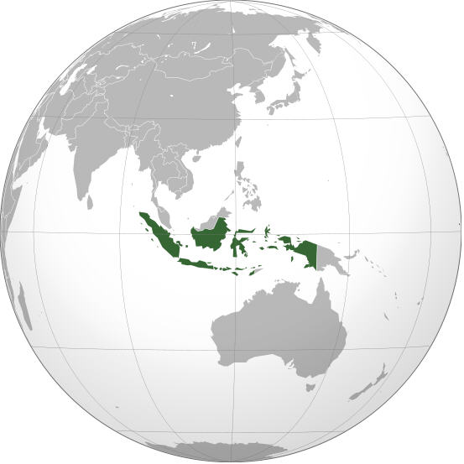

Integrated Health Services
District Level
Provincial Level
National
Level
District Health Office
Provincial Health Office
Ministry of Health
Primary
Health
Centers
Hospitals
Hospitals
Hospitals
Basic Health Services
Referral Health Services
INTEGRATED SUPPLY CHAIN MANAGEMENT
Notes:
For some background, this is a diagram of the vision for integrated health services in Indonesia. You will see at the far right is the Ministry of Health at the central level, and as you move to the left the health system is organized by provincial health offices and district health offices. Service delivery for basic health services are provided through primary health centers and are managed by district health offices. Referral health services are provided through hospitals, which can be managed by district or provincial health offices, and in some cases directly by the national Ministry of Health.
Given this vision for integrated health services, Indonesia believes that it is essential for the health system to be supported by comprehensive, integrated supply chain management. Supply chain management is not only about carrying out supply chain processes such as forecasting, procurement, and warehousing—what is most important is that there are competent people working together across the supply chain to ensure quality service delivery.

Slide 8
One Gate Policy
Aligning all programs through the One Gate Policy
Start by centralizing the coordination of health commodities procurement among various programs
The People that Deliver initiative will follow the One Gate Policy to align human resources and program coordination
8
Notes:
As the situation is not ideal in terms of efficiency and service delivery, the MOH initiated a One Gate Policy for health commodities, which aims to centralize the drug procurement process across all programs.
Since the One Gate Policy already had significant momentum within the MOH, it made sense to us to also include People that Deliver to support the One Gate Policy, and use it as an opportunity to align human resources and coordination among programs.
The long term view is to have one MOH unit that responsible for SCM.
To make the policy work, one key component is adequate human resource availability for supply chain operations.

Slide 9
PtD IS A FORUM TO BRIDGE PROGRAM, PHARMACY AND PARTNERS
“Community” with same commitment for qualiity drug management
Forum to allow communication and meetings to develop community documentS and achieve community goals and objectives.
9

Slide 10
PtD Strategic Objectives
Develop a network of SCM professionals within MOH.
ONE GATE POLICY
I
Increase awareness and advocacy of human resources for SCM.
II
Increase the technical skills of SCM professionals.
III
Develop the One Gate Policy to coordinate supply chain people and processes.
IV
V
Develop a career path for SCM professionals.
Address the challenges of financial human resources for SCM.
VI
10
Notes:
In line with the One Gate Policy, PtD Forum has defined six strategic objectives.
The first three objectives are short-term quick wins that can have tangible outcomes within the next year. The MOH will work to develop a network of supply chain professionals within the MOH, facilitating communication and collaboration across various programs to address common challenges. Additionally, the MOH will develop an evidence base and resources and tools to increase awareness of human resource challenges
In the medium to long term, the MOH will work to further define and document the One Gate Policy, particularly as it relates to supply chain people and processes. We would like to develop a career path for supply chain professionals, so that people who develop supply chain expertise in one program could also make their skills useful in other programs. As we expand our supply chain human resources, we will also need to address how the government can properly finance these changes.

Slide 11
CURRENT PtD ACTIVITIES (1)
NATIONAL DRUG SCM STRATEGY-2014 TO 2016.
DOCUMENT AND SOCIALIZE KEY “ONE GATE” SCM INTEGRATION POLICY.
DEVELOP GOOD WAREHOUSE PRACTICES

Slide 12
CURRENT PtD ACTIVITIES (2)
4. GF HSS DISTRICT BASED SCM SUPPORT PILOT PROJECT.
5.PROVINCIAL PtD LOGISTICS NETWORK
6.SUPPORT THE MOH NEW SCM POLICES FOR THE UNIVERSAL HEALTH INSURANCE PROGRAM .

Slide 13
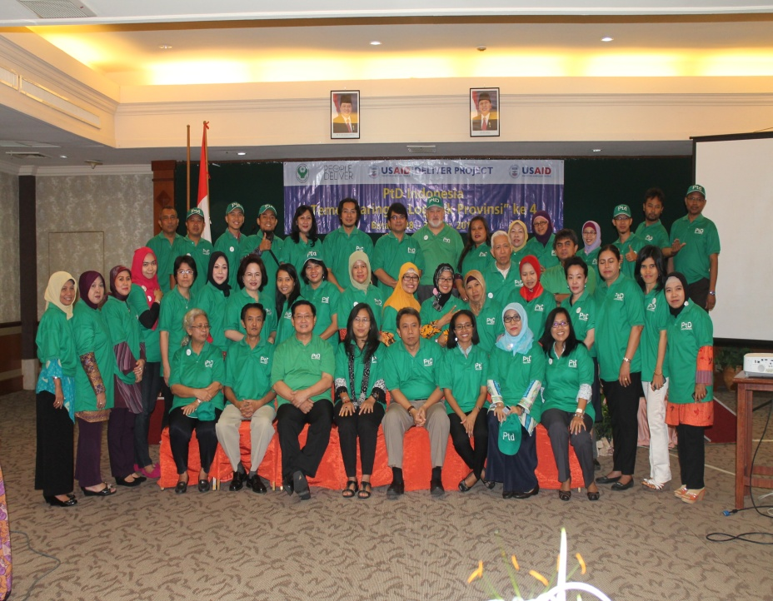
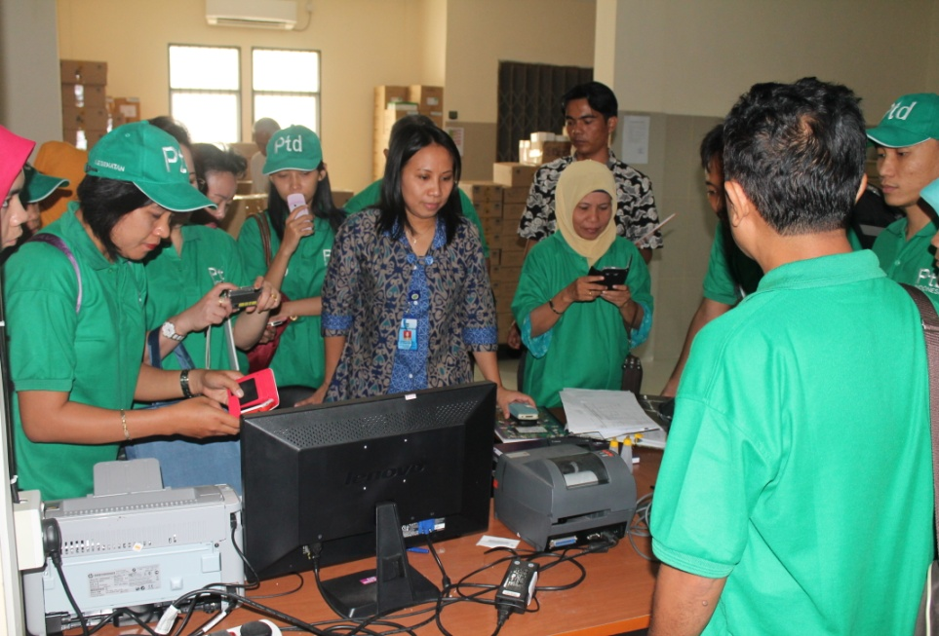
PtD Indonesia Activities Photo (1)

Slide 14
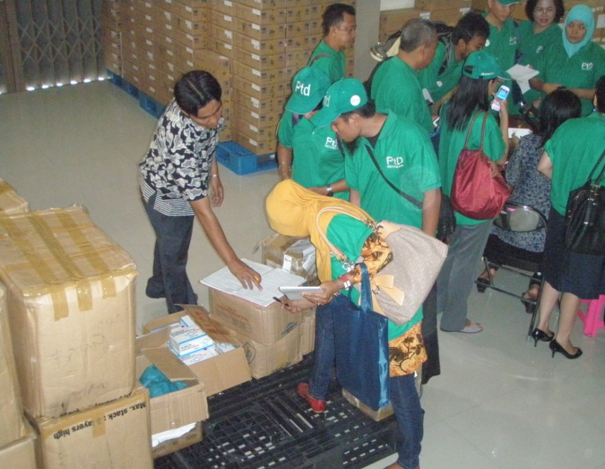
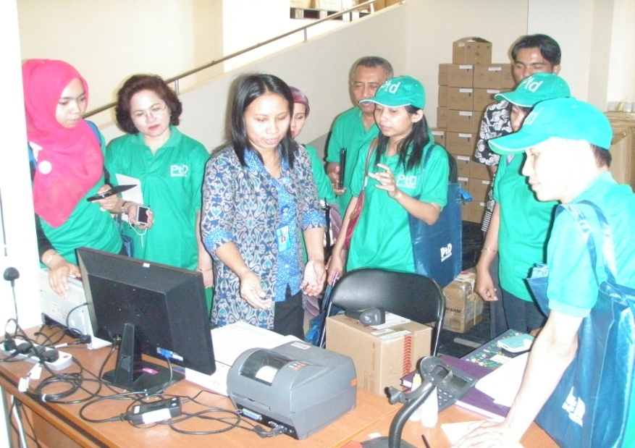
PtD Indonesia Activity Photos (2)

Slide 15
TERIMA KASIH
THANK YOU

