Slide 1
SCM
Professionalisation Framework
WORKSHOP PRESENTATION
Promoting sustainable workforce excellence in health supply chain management

Slide 2
SCM Professionalisation Framework
Overview
Who we are
Why do we focus on HR for SCM
Meeting the needs of the future supply chain workforce
Understanding labour markets
Supply and demand
SCM labour market analysis in Rwanda
How to catalyse and stimulate the SCM labour market?
Four components of the SCM professionalisation framework
www.peoplethatdeliver.org

Slide 3
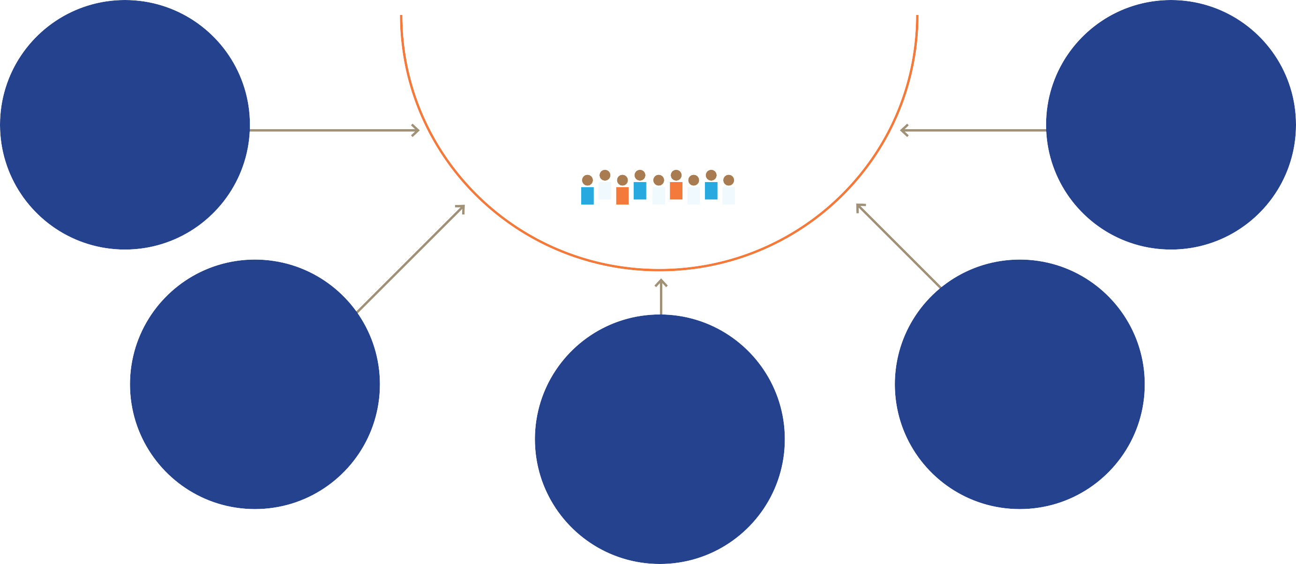
Why do we focus on HR for SCM?
Issues facing HR in SCM
Fragmentation of the responsibility for managing the
overall performance of the supply chain
Supply chain workforce
Lack of professional development & professional association
Lack of planning & financing for the supply chain workforce
Lack of accurate job descriptions
Lack of development & credentialing of supply chain managers
www.peoplethatdeliver.org

Slide 4
Increasing pressure on health supply chains
24-fold increase in the value of new vaccines introduced into a country…
… resulted in a 5-fold increase in the workload for supply chain management
www.peoplethatdeliver.org

Slide 5
Meeting the needs of the future supply chain workforce
Requires systems thinking!
Recognition that the SC workforce is more than warehouse clerks and managers, but includes regulatory & procurement functions, data analytics, strategic man- agement and leadership.
Understanding SC labour markets
The educational and training institutions that output qualified workers
Polices and regulations that determine requirements of supply chain personnel and influence career paths
Dynamics that influence movements of SC workers between organisations and between sectors
Across different sectors
Capacity development must occur at multiple levels individual, organisational and societal
Public
Commercial
Civil society
www.peoplethatdeliver.org

Slide 6
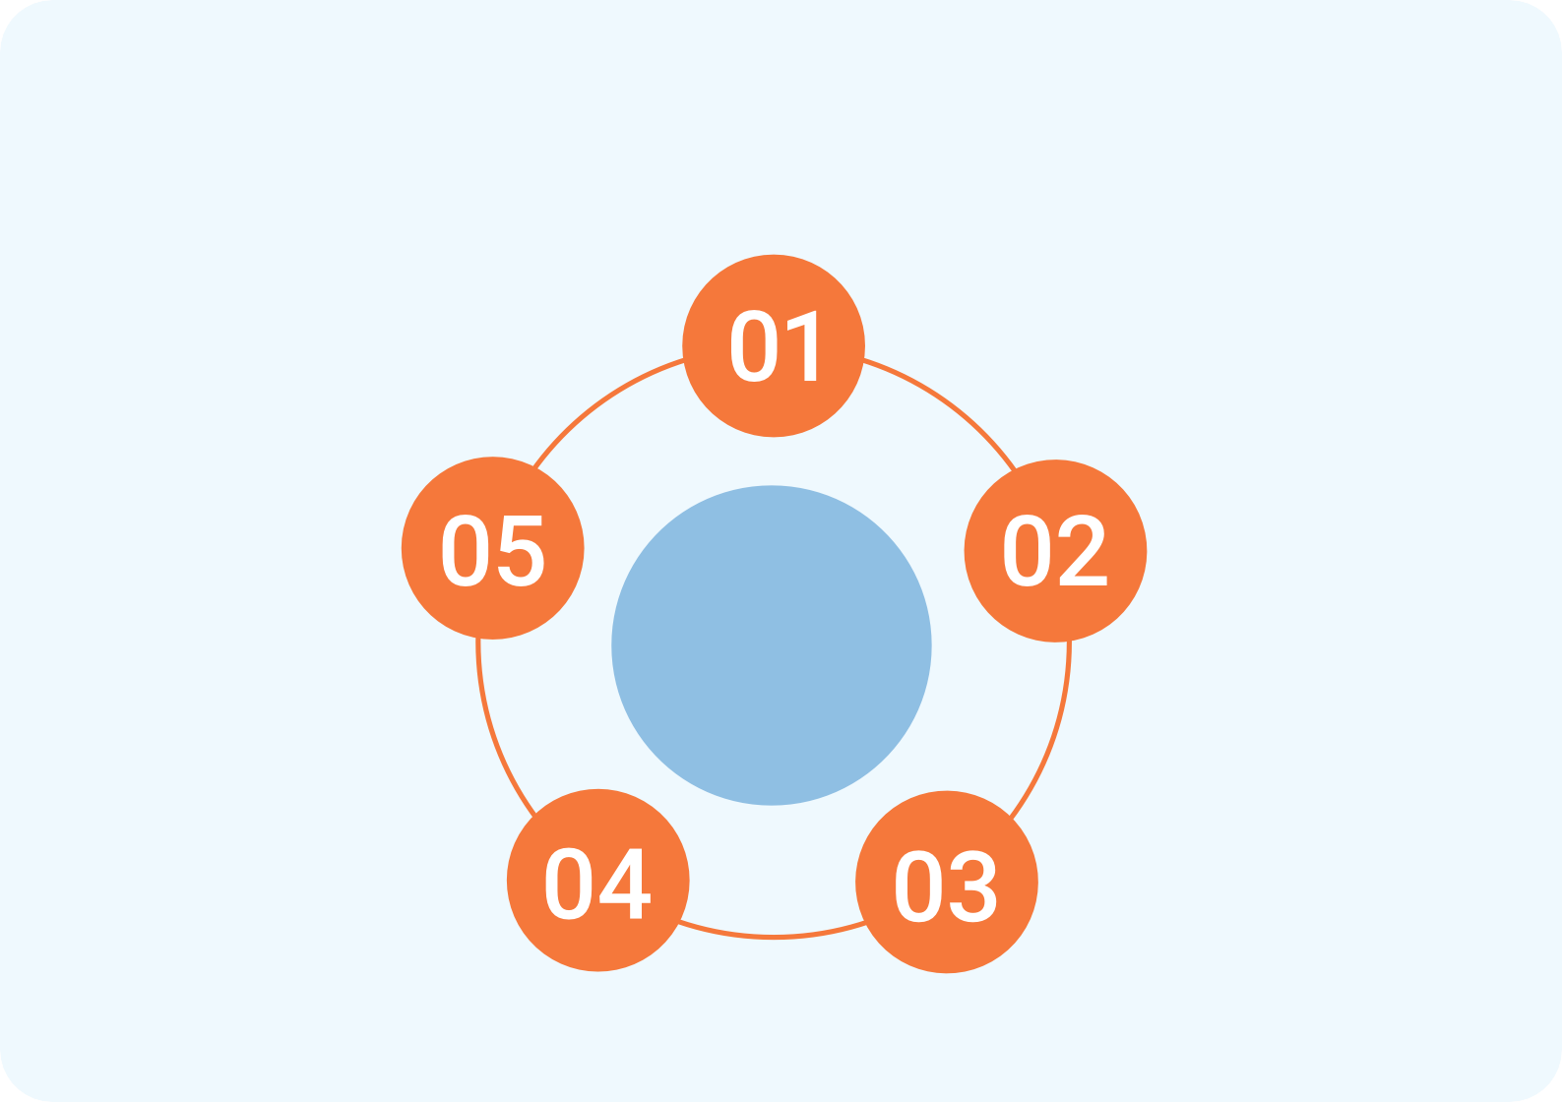
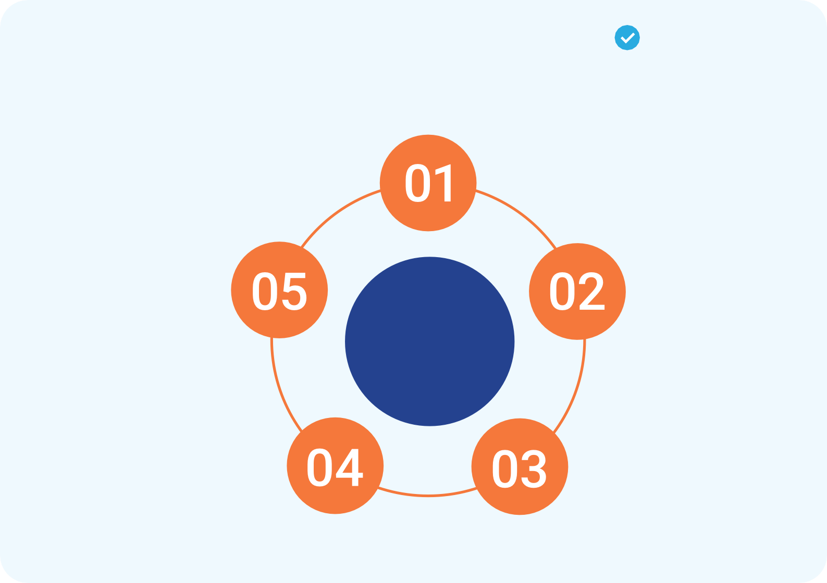
Lack of professional status and performance
Health supply chains are a key enabler for increasing the availability of life-saving medicines and other health commodities.
The challenge is to ensure enough professionals have the competencies required for effective SCM of health products.
Current paradigm
Staff rotation / migration
Desired paradigm
National institutions provide relevant qualifications
Limited available resources and incentives
SC workforce positions do not require relevant SC qualifications
SC jobs desirable; qualifications
sought
Qualified staff hired/contracted for SC positions
Lack of professional status & performance
Elevated Status for the SC and SC workforce
Short term training provided
Short-term training provided
Clinical staff fill SC position
High staff satisfaction
Appropriate career incentives provided
Clinical Staff fill
SC Position
High staff satisfaction
Appropriate career incentives provided
www.peoplethatdeliver.org

Slide 7
Understanding labour markets
Demand
for a competent SCM workforce: employers
Supply
of a competent SCM workforce: employees
www.peoplethatdeliver.org

Slide 8
The supply
Competency areas and behaviours
Knowledge, skills and abilities needed for the job
Paths to professionalisation
Professional development and academic accreditation
Professional accreditation
Short courses
Academic accreditation
Fill the knowledge gap
www.peoplethatdeliver.org

Slide 9
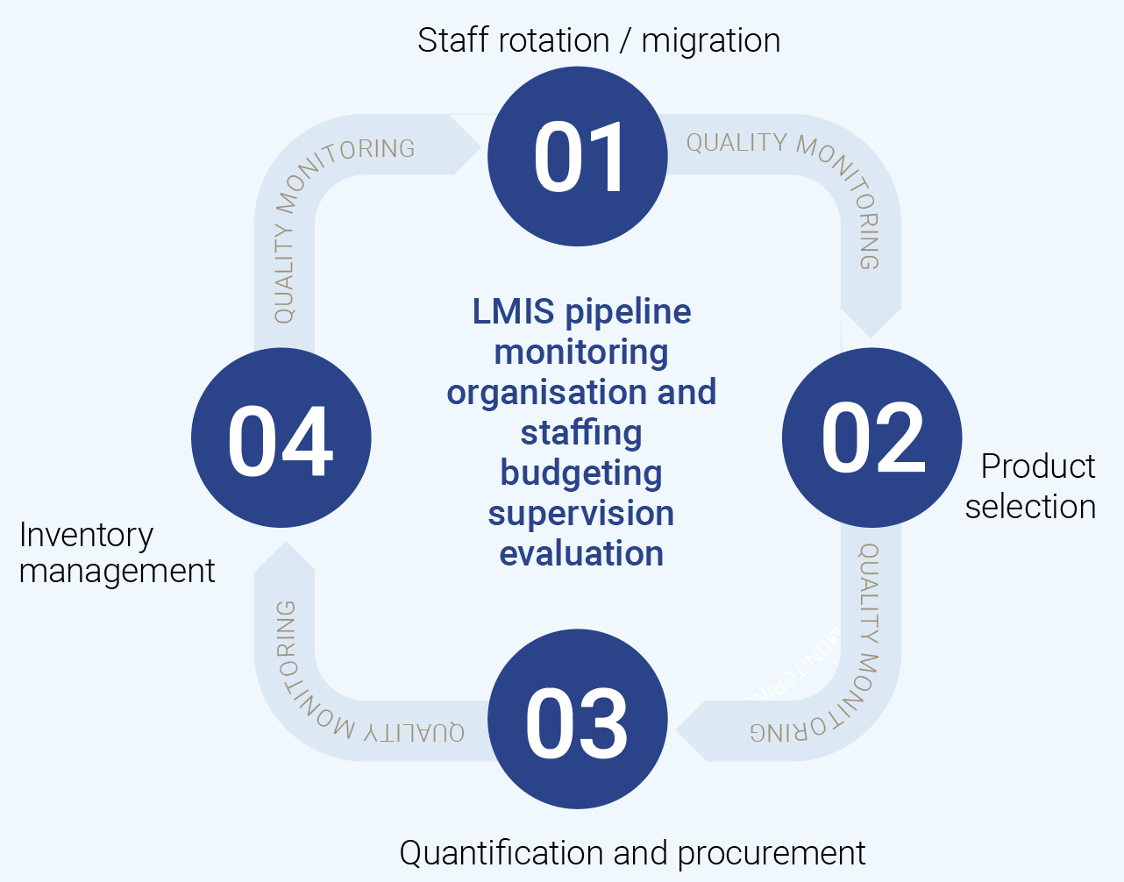
SCM competencies
EXAMPLE:
People that deliver competency framework for health supply chain management
Competency Behavioural competencies
1.1 Select the appropriate product | Describe the broad concepts of National Medication Policy, Essentials Medicine Lists, Essential Equipment Lists, Standard Treatment Guides and “Dangerous Drug” (DDA) or narcotics Policy
 | Use the processes required to add and subtract items from the Essential Medicines List and the Essential Equipment List
 | Follow the process required to alter standard treatment guidelines, dangerous drug policy and national medication policy
 | Confirm the type of supplies and services that are required
www.peoplethatdeliver.org

Slide 10
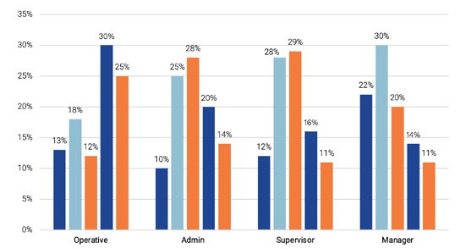
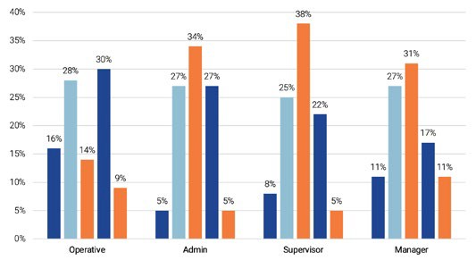
The demand
Availability of qualified staff: geographical split
Emerging regions
Please indicate the availability of employee groups by country for the following four employees group of your country
Developed regions
Please indicate the availability of employee groups by country for the following four employee groups in your country
35%
35%
35%
52%
44%
32%
33%
38%
In emerging markets, main shortage is at the managerial level
In developed countries, main shortage is at the operative level
www.peoplethatdeliver.org

Slide 11
Benefits of professionalisation?
Defined standard of competence for a set of tasks within the supply chain
Improved supply chain management outcome
Creation of a pool of correctly skilled workforce
in private & public
Scalable method of creating continuous flow of correctly skilled individuals
Create a sense of identity
& prestige
Exponential improvement in supply chain
management practices deployed in
country
www.peoplethatdeliver.org

Slide 12
SCM Professionalisation Framework can be used by:
Governments to define standards
Employers to define competency needs
Institutions of learning to define teaching
Employees to map careers
www.peoplethatdeliver.org

Slide 13
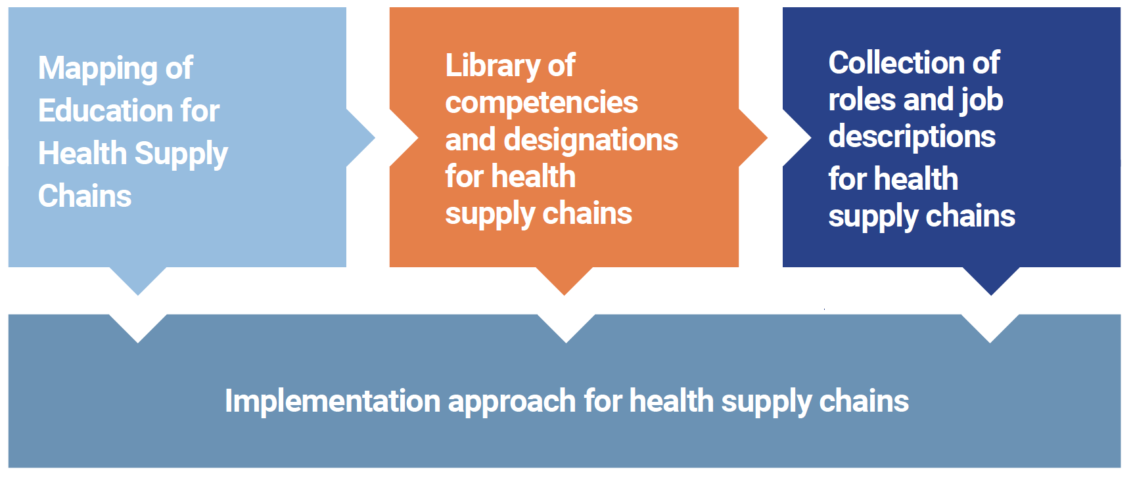
How to catalyse & stimulate the SCM labour market?
Supply
Demand
www.peoplethatdeliver.org

Slide 14
Mapping of education for health supply chains
Associate
Practitioner
Specialist
Professional
Leader
Mapping of education for health supply chains
e.g. Skills programs
e.g. Diploma, skills programs
e.g. Bachelor's degree, APICS CLTD
e.g. Master's, high degree, APICS CSCP
e.g. Masters, PhD, APICS CSCP
Academic and professional education pathways that align with the suggested job roles and job descriptions
Job roles are aligned with a career path for SCM professionals that can be adopted by professional associations and/or professional councils
Shows clear education and career pathways for SCM professionals across the competency framework
Moving between “Plan” through “Return” and from “Associate” to “Leader”
www.peoplethatdeliver.org

Slide 15
Mapping of education for health supply chains
Maturity level
Library of competencies and designations
for health supply chains
Associate
Practitioner
Specialist
Professional
Leader
Forms the core of the SCM professionalisation framework
Standard competencies that includes technical and managerial elements
Includes a maturity approach as staff move from “Associate” to “Leader”
www.peoplethatdeliver.org

Slide 16
Mapping of education for health supply chains
Associate
Practitioner
Specialist
Professional
Leader
Collection of roles and job descriptions
for health supply chains
E.g. Clerk – receiving
E.g. Officer – receiving
E.g. Manager - logistics planning
E.g. Lead - procurement
E.g. Director – public health supply chain
Range of SC roles with associated job descriptions that spans the width of SCM competencies
Includes example organograms and job descriptions, including reference to key performance indicators
Aligned with the designations and career maturity (e.g., from associate to leader)
Aligned to the education and training
www.peoplethatdeliver.org

Slide 17
Implementation approach for health supply chains
www.peoplethatdeliver.org

Slide 18
Implementation approach for health supply chains
CDP
Approval
Actual Training Report (ATR)
Identify Environment
Identify Project Team
Capacity Development plan(CDP)
Stakeholder buy-in
Personal Development plan
Awareness building
Capacity Development priorities
Training needs analysis (TNA)
Role Based Competency Assessment
Process Aligned job descriptions
TOC & SC process & Skills definition
www.peoplethatdeliver.org

Slide 19
Implementation approach for health supply chains
CDP
Approval
Actual Training Report (ATR)
Identify Environment
Identify Project Team
Capacity Development plan(CDP)
Stakeholder buy-in
Personal Development plan
Awareness building
Capacity Development priorities
Training needs analysis (TNA)
Role Based Competency Assessment
Process Aligned job descriptions
TOC & SC process & Skills definition
www.peoplethatdeliver.org

Slide 20
Implementation approach for health supply chains
CDP
Approval
Actual Training Report (ATR)
Identify Environment
Identify Project Team
Capacity Development plan(CDP)
Stakeholder buy-in
Personal Development plan
Awareness building
Capacity Development priorities
Training needs analysis (TNA)
Role Based Competency Assessment
Process Aligned job descriptions
TOC & SC process & Skills definition
www.peoplethatdeliver.org

Slide 21
Supply chain process selection
Objectives
» Align current in country supply chain activities with competency framework
» Agree on champion organisation for professional body
Inputs
» Project charter
» Organisation processes aligned to technology and practices
» Human resources assignments by process
» Job descriptions
» Organisational WSPs
Activities
» Gathering of process documentation from all organisations (link to documentation already collected)
» Gathering of human resource assignments
» Selection of processes from original scope defined in project charter
» Gather educational course data for health supply chain
» Gather professional association data and requirements looking for supply chain custodianship
» Evaluation of process elements for competency framework
Outputs
» Supply chain activity selection Summary
» Process aligned suite of competency categories (what is in and what is out)
» Supply chain professional body agreement
www.peoplethatdeliver.org

Slide 22
Role alignment
Objectives
» Translation of SCM process to role and alignment of roles to designations and careers paths
Inputs
» Supply chain activity selection summary
» Repository of job descriptions
» Library of competency’s (subset from previous step, whats left in)
» Mapping of education
Activities
» Definition of designation competencies with qualification and professional credentialing
» Alignment of SCM process process to Repository of Job Descriptions
» Alignment of SCM job roles to designation level
» Alignment of additional designation requirements e.g. ethical, process for designation, Public service commission,
non-competency-based
considerations (authority of a designee)
Outputs
» Country specific designation framework and career paths
» Country specific repository of job descriptions with country specific serialisation
www.peoplethatdeliver.org

Slide 23
HR Requirements analysis
Objectives
» Define gaps discovered through alignment of roles and competencies to processes
Inputs
» Country specific repository of job descriptions with country specific serialisation
» Current organisation organogram and associated job descriptions
Activities
» Comparison of current organisation organogram and associated job descriptions to new country specific repository of job descriptions
» Comparison of competencies in job descriptions to education availability
» Definition of total in-country qualification, professional credentialing offering gap
» Creation of competency-based assessments by job role
Outputs
» Overall qualification and professional credentialing development summary
» Mapping of current employees to new job roles
» Competency-based assessment tools (observational, quiz, tests)
www.peoplethatdeliver.org

Slide 24
S3.4 Role based competency assessment
Objectives
» Roll out competency-based assessments and define competency gaps
Inputs
» Overall education development summary
» Mapping of employees to job roles
» Suite of competency-based assessments
Activities
» Assessment assignment and measurement
» Optimisation of educational requirements
Outputs
» Training needs report
www.peoplethatdeliver.org

Slide 25
Supply chain human resources performance alignment
Objectives
» Define baseline metrics for individuals and supply chain performance based on selected KPIs
Inputs
» Last key performance indicator for individuals and supply chains
» Training needs report
Activities
» Analyse and document key supply chain performance indicators against training needs
» Compare KPIs to interventions identified in previous step and rank according to KPIs
» Develop capacity development priorities with individual and staff component
» Acquire approval for capacity development priorities with individual and staff component
Outputs
» Ranked initiatives for improvement based on educational, process and performance gaps in capacity development priorities
» Signed off for capacity development plan with individual and staff component for approval to continue to step 4
Notes
May require KPI definition and first measurement as part of process analysis
www.peoplethatdeliver.org

Slide 26
Implementation approach for health supply chains
Capacity Development plan(CDP)
Personal Development plan
www.peoplethatdeliver.org

Slide 27
Develop professionalisation plan
Objectives
» To develop the project plan for professionalisation including designation, education and mentorship
Inputs
» Capacity development priorities
» Designation requirements
Activities
» Develop plans based on optimisation quantifying the number and potential time horizon of interventions
» Develop professional council activities
» Develop organisation activities
» Develop country activities
» Develop academic activities
» Engage with professional bodies to assist in professionalisation activities
Outputs
» Professionalisation plan
www.peoplethatdeliver.org

Slide 28
Create personal development plans
Objectives
» Creation of personal development plans from capacity development plan
Inputs
» Capacity development portfolio
» Professionalisation plan
» Succession planning initiatives
» Performance management initiatives
» Available education and training
Activities
» Review role-based recommendation from capacity development plan including CPD requirements
» Analyse individual recommendation from capacity development plan including cpd requirements
» Individual conversations based on hr recommendation from capacity development plan
» Develop individual plans and get buy in from employee
Outputs
» Personal development plans
www.peoplethatdeliver.org

Slide 29
S4.3 Develop Capacity Development Plan
Objectives
» To quantify and plan organisation wide education and designation activities and balance to available resources
Inputs
» Professionalisation plan
» Professional development plan
» Funding and budgets available
Activities
» Prepare schedule of groups of employees against professionalisation plan and PDPs
» Prepare costing for proposed interventions
» Balance interventions against funding and budgetary constraints
Outputs
» Organisational capacity development plan for all included organisations
www.peoplethatdeliver.org

Slide 30
Organisational improvement summary
Objectives
» Linking professionalisation with intended organisational performance for the executive. Embedding professionalisation into the dna of the organisation
» To get confirmed buy-in from the executive with required resources to progress the plan
Inputs
» Professionalisation plan
» Organisation capacity development plan
Activities
» Quantify costs for professionalisation
» Qualify benefits to professionalisation and position it in the larger HR landscape (theory of change)
» Perform advocacy for on-going professional development
» Ensure appropriate positioning of professionalisation in line with other strategic interventions
» Seek sign off for organisation capacity development plan
Outputs
» Benefits summary
» Signed off organisation capacity development plan for permission to enter step 5
www.peoplethatdeliver.org

Slide 31
Implementation approach for health supply chains
Stakeholder buy-in
Awareness building
www.peoplethatdeliver.org

Slide 32
S5.1 Organisational improvement summary
Objectives
» Roll-out approved organisational capacity development plan
Inputs
» Approved benefit summary
» Approved organisational capacity development plan
» Approved professionalisation plan
Activities
» Trigger planned interventions
» Manage planned interventions
Outputs
» Actual training report (on-going)
» SC KPI reporting (on-going)
www.peoplethatdeliver.org

Slide 33
S5.2 Onboard for business as usual
Objectives
» Integrate and create formal structures to manage the ongoing professionalisation
Inputs
» SC KPI tracking reports
» Actual training reports
» Improvement portfolio
Activities
» Analyse total benefit
» Define on-going structures
» Begin process for review of project charter
» Begin process for review country specific job descriptions
» Begin process for review of country specific designation framework
» Begin process for review country specific education
» Acquire sign off for Step 1
Outputs
» Adjusted plans based on new realities and sign-off for step 1
www.peoplethatdeliver.org

Slide 34
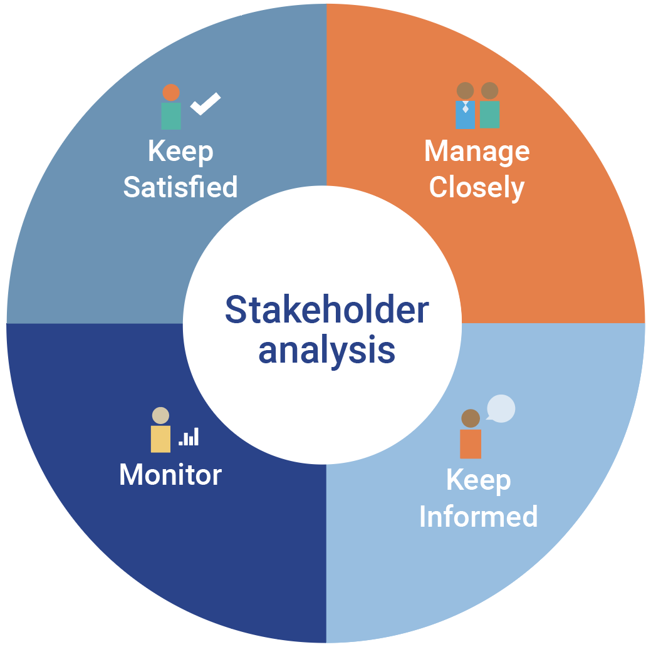
Scope definition
Text here
Text here
Text here
Text here
www.peoplethatdeliver.org

Slide 35
Role alignment
Sponsor
In-country representative
Coach
Working groups
www.peoplethatdeliver.org

Slide 36
Questions?
www.peoplethatdeliver.org

