Slide 1
Supply Chain Governance and Workforce Development Framework
User Guidance Document
05 November 2021
Picture: Global Fund Instagram / Ricci Shryock

Slide 2
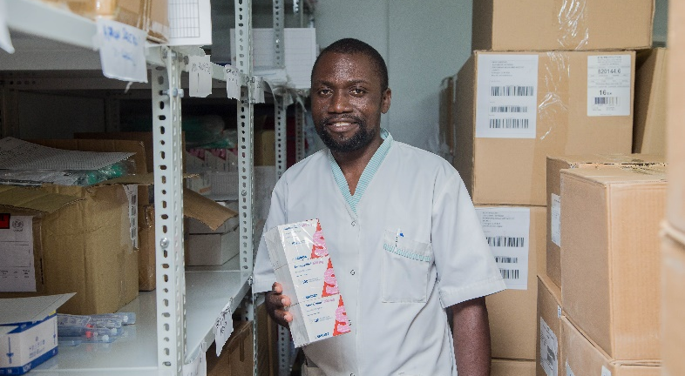
Global Fund’s Purpose and Vision for Supply Chain
Global Fund’s Purpose: To end the epidemics of HIV / TB / Malaria, and to support countries in achieving SDGs.
The Global Fund Strategy 2017-2022 (& Beyond)
TGF Supply Chain Dept. Vision
(SC Roadmap)
Supply Chain Department Vision: Strengthen and accelerate the development of efficient, agile, people centric and sustainable national health system supply chains to ensure equitable access to quality assured & affordable health products -- (SC Roadmap)
Picture: © UNICEF / Manyamba
Notes:
To begin with, let’s view The Global Fund’s overall purpose and vision, and the Supply Chain Team and its vision contribute to it.
The latest Supply Chain Roadmap (which is being currently validated), emphasizes on ‘People Centric’ supply chains to ensure equitable access to quality assured & affordable health products.
This is very important for the current context in several Global Fund’s portfolio countries where significant investments have been made on developing and strengthening systems and though the systems have enormous potential, it is not being fully realized because of lack governance and human resource capacity. Hence, it is important to refocus some of TGF’s time and energy towards building human capacity and governance systems.

Slide 3
Global Fund’s Supply Chain Investment Areas to Achieve the Vision
SC Vision:
Strengthen and accelerate the development of efficient, agile, people centric and sustainable national health system supply chains to ensure equitable access to quality assured & affordable health products.
Investment Areas: As per Supply Chain Roadmap
Coordination & Advocacy | Change Catalyst | Capacity Development | Fostering Innovation | Optimizing Investments in SC
Strengthen existing donor coordination mechanisms to facilitate alignment on priorities and agendas in support of country needs. | Support MoH to develop comprehensive national SC strategic plans | Analyze SC related data to assess capacity and capabilities to identify priority areas | Support the development of innovative solution for data management such as crowd sourcing platforms to improve access beyond health facilities, innovative data reporting tools. | Regularly meet with other donors to share and align investment agendas at global and local level (e.g., through quarterly meetings)
Reinforce and leverage existing coordination mechanisms at country level | Understand successes and failures of past strategies, identify benchmarks and identify best practices to be replicated, including country stewardship in the development of national SC strategies | Assess in country SC design, networks, infrastructures and performance and provide guidelines to improve it | Finance non-traditional players / small players / PRs developing new solutions in collaboration with ministries and governments (e.g., improvement of distribution) | Jointly develop with partners standard investment cases , with differentiated time horizons corresponding to the specificities of each investment (e.g., MIS, etc.)
Map stakeholders' SC engagement to define strategies & align investments | Share best practices with countries and support development of application & standards to drive Supply Chain operations (incl. information system implementation, private sector engagement, | Support organizational design to include adequate SC roles, appropriate recruitment, retention and motivation practices (incl. ongoing capacity development) | Analyze and leverage private sector strategies & best practices to develop public competencies | Through Strategic Initiatives, ensure the financing of critical SC enablers based on in country SC performance
Ensure effective partner engagement in the review of country grant applications, aiming the right level of ambition & financing to support SC strengthening efforts | Support routine maturity assessments of national SC to inform progress monitoring, investment planning and updating of established masterplans | Support the design of new SC ownership / governance models and accountability mechanisms, in close collaboration with governments and donors | Develop a knowledge hub / Center of expertise on SC topics to share best practices among countries, external partners and private sector players | Use data driven approaches to drive efficiency and to identify the most critical risks & needs in countries, to be financed through grants
Leverage catalytic funding from strategic initiatives to improve grant spending and advocacy of best practices (e.g., private sector engagement) | Conduct market assessment of service providers (e.g., 3PLs and 4PLs) for key functions, and encourage contracting of 3PL and 4PL providers | Provide best practices to define and implement efficient performance KPIs , tools for SC oversight, and process sustainability (SOPs, job aids, daily management systems, | Map innovation agenda of external partners to ensure coordination on innovation work, leverage best approaches, and avoid duplication of effort | Advise countries on optimal investments to be made to address identified needs and risks
Provide support to SC forums (e.g., GHSC summit, HHL Conference, GS1 summit, etc...) to increase visibility of SC improvement activities & lessons learnt globally | Promote the adoption of tools and processes to increase efficiency and effectiveness of the supply chain (e.g., Lean Six Sigma, root cause analysis, economic cost analysis | Provide inputs on prioritized topics : leadership [STEP], development of specific skills in a sustainable way, etc. | Develop partnerships with educational institutions (e.g., professional associations, universities) and SC organizations to generate SC innovations incubators | Advise countries on how to articulate the different steps of the SC investment activities
*Not All areas are listed in the table
Notes:
As per the vision enumerated in the SCR, The Global Fund’s supply chain team may decide to take on 5 different thematic roles for its future investments in supply chain systems. These thematic roles are designed for a 360 degree development of a country’s supply chain and health system.

Slide 4
Investment Areas quite similar to Supply Chain Roadmap were also depicted in the PSM – Strategic Initiative 2021-23, and the TA pool instituted The Global Fund’s Supply Chain team were given 4 workstreams under which Investments were supposed to be made.
The next slide depicts these 4 workstreams under PSM – SI 2021-23

Slide 5
Workstreams under PSM-SI 2021-23
Sustainable Governance | Planning & Innovation | Supply Chain Design | Private Sector Engagement
Evaluate capacities, capabilities, working conditions and motivations of human resources (within MOH, PRs, CMSs and other entities) to identify the skills and staff required to deliver on programmatic priorities. | Conduct stakeholder readiness, market analysis, packaging analysis, information systems analysis | Assess and redesign existing storage and distribution networks to achieve consolidation and centralization of storage locations, crossdocking capacity and route optimization | Support the development of country appropriate policy using toolkits, best practices and south-to-south dialogues to catalyze private sector engagement
Develop long-term country SC master plans and SC human resources for health guiding policies to support strengthening of capabilities and capacities within the supply chain entities | Rationalization and standardization of all Master Data in systems | Assess warehouses for compliance, capacity, suitability for storage of pharmaceutical products and identification of required improvements using lean six sigma approach | Develop and implement strategies, capabilities and best practices to integrate private sector partners into the SC as long-term strategic partners
In line with national needs and policy frameworks, develop tailored SC capability development programs to address gaps and ensure sustainable capacity building | Support the implementation of information systems (global goods) including LMIS, LIS, WMS, RIS, control towers, transit applications and relevant dashboards | Design alternative or differentiated distribution models for specific products | Conduct a rapid assessment of service providers (3PLs and 4PLs), for key functions including, warehousing, distribution, pharmacies and retailers, and match with the country’s specific needs
Where needed, develop cross-functional high performing SC units | Enable the Global Fund, USAID and others to trace and track products (e.g., using GS1 standards). | Re-design order management process to allow for full visibility, faster order flows and improved order fulfilment | Development of long-term, cost-competitive and service-driven framework agreements for 3PL and 4PL providers
Design online SC training programs and integrate within pre-service and in-service training curriculum in national systems | Strengthen data sharing and integrated analytics between program (HMIS) and logistics (LMIS) information and WMS in priority countries | Design and optimize waste management network to improve storage capacity at health facilities | Implement best practice contract structures and develop skills to manage contracts and framework agreements, service level agreements and/or performance-based contracts
Consistently evaluate the impact of trainings to ensure they are delivering on stated objectives | Strengthen capacity to identify data needs for solving problems and to interpret and use data appropriately for public health/SC decisions; enhance the capacity of technical advisors to effectively provide quality data to decision makers |  | Map criteria for segmenting outsourced operations and in-house operations in the end-to-end SC and clarify roles and responsibilities
In close collaboration with governments and donors, design future SC governance models that will facilitate increased ownership, including self-financing and management of all SC functions | Strengthen demand and supply planning processes using artificial intelligence
*All sub-workstreams and their descriptions are sourced from SCTA RFP
Notes:
Similar to SCR, the TGF’s PSM – Strategic Initiative 2021-23 has 4 different workstreams which was designed to holistically develop a country’s supply chain capability.
Both the approaches SCR and PSM-SI have significant investments suggested towards organizational governance and workforce development. The following set of slides attempts to focus on several governance and workforce development investment areas depicted in SCR and PSM-SI. This is to recognize the G&WD is an important element for TGF’s future investment portfolio.

Slide 6
Governance & Workforce Development:
Heavily features in both SCR and PSM SI
Let’s view the investment areas under SCR which can be categorized under Governance and Workforce Development – highlighted in Green (definitions on Slide 18)
Coordination & Advocacy | Change Catalyst | Capacity Development | Fostering Innovation | Optimizing Investments in SC
Strengthen existing donor coordination mechanisms to facilitate alignment on priorities and agendas in support of country needs. | Support MoH to develop comprehensive national SC strategic plans | Analyze SC related data to assess capacity and capabilities to identify priority areas | Support the development of innovative solution for data management such as crowd sourcing platforms to improve access beyond health facilities, innovative data reporting tools. | Regularly meet with other donors to share and align investment agendas at global and local level (e.g., through quarterly meetings)
Reinforce and leverage existing coordination mechanisms at country level | Understand successes and failures of past strategies, identify benchmarks and identify best practices to be replicated, including country stewardship in the development of national SC strategies | Assess in country SC design, networks, infrastructures and performance and provide guidelines to improve it | Finance non-traditional players / small players / PRs developing new solutions in collaboration with ministries and governments (e.g., improvement of distribution) | Jointly develop with partners standard investment cases , with differentiated time horizons corresponding to the specificities of each investment (e.g., MIS, etc.)
Map stakeholders' SC engagement to define strategies & align investments | Share best practices with countries and support development of application & standards to drive Supply Chain operations (incl. information system implementation, private sector engagement, | Support organizational design to include adequate SC roles, appropriate recruitment, retention and motivation practices (incl. ongoing capacity development) | Analyze and leverage private sector strategies & best practices to develop public competencies | Through Strategic Initiatives, ensure the financing of critical SC enablers based on in country SC performance
Ensure effective partner engagement in the review of country grant applications, aiming the right level of ambition & financing to support SC strengthening efforts | Support routine maturity assessments of national SC to inform progress monitoring, investment planning and updating of established masterplans | Support the design of new SC ownership / governance models and accountability mechanisms, in close collaboration with governments and donors | Develop a knowledge hub / Center of expertise on SC topics to share best practices among countries, external partners and private sector players | Use data driven approaches to drive efficiency and to identify the most critical risks & needs in countries, to be financed through grants
Leverage catalytic funding from strategic initiatives to improve grant spending and advocacy of best practices (e.g., private sector engagement) | Conduct market assessment of service providers (e.g., 3PLs and 4PLs) for key functions, and encourage contracting of 3PL and 4PL providers | Provide best practices to define and implement efficient performance KPIs , tools for SC oversight, and process sustainability (SOPs, job aids, daily management systems, | Map innovation agenda of external partners to ensure coordination on innovation work, leverage best approaches, and avoid duplication of effort | Advise countries on optimal investments to be made to address identified needs and risks
Provide support to SC forums (e.g., GHSC summit, HHL Conference, GS1 summit, etc...) to increase visibility of SC improvement activities & lessons learnt globally | Promote the adoption of tools and processes to increase efficiency and effectiveness of the supply chain (e.g., Lean Six Sigma, root cause analysis, economic cost analysis | Provide inputs on prioritized topics : leadership [STEP], development of specific skills in a sustainable way, etc. | Develop partnerships with educational institutions (e.g., professional associations, universities) and SC organizations to generate SC innovations incubators | Advise countries on how to articulate the different steps of the SC investment activities
*The SCR is still under validation
Notes:
This slide shows (green cells) those investment areas within the 5 thematic roles of SCR which are related to Governance and Workforce Development. It is important to note that it is not just the thematic role #3 – Capacity Development which is linked to G&WD, there are several investments areas under other thematic roles which has various G&WD elements such as training, community development, collaboration amongst organizations, development and dissemination of tools and resources to staff, partnerships with education institutions etc.

Slide 7
Governance & Workforce Development:
Heavily features in both SCR and PSM SI
Let’s now view the investment areas under PSM-SI which can be categorized under Governance and Workforce Development – highlighted in Green.
Sustainable Governance | Planning & Innovation | Supply Chain Design | Private Sector Engagement
Evaluate capacities, capabilities, working conditions and motivations of human resources (within MOH, PRs, CMSs and other entities) to identify the skills and staff required to deliver on programmatic priorities. | Conduct stakeholder readiness, market analysis, packaging analysis, information systems analysis | Assess and redesign existing storage and distribution networks to achieve consolidation and centralization of storage locations, crossdocking capacity and route optimization | Support the development of country appropriate policy using toolkits, best practices and south-to-south dialogues to catalyze private sector engagement
Develop long-term country SC master plans and SC human resources for health guiding policies to support strengthening of capabilities and capacities within the supply chain entities | Rationalization and standardization of all Master Data in systems | Assess warehouses for compliance, capacity, suitability for storage of pharmaceutical products and identification of required improvements using lean six sigma approach | Develop and implement strategies, capabilities and best practices to integrate private sector partners into the SC as long-term strategic partners
In line with national needs and policy frameworks, develop tailored SC capability development programs to address gaps and ensure sustainable capacity building | Support the implementation of information systems (global goods) including LMIS, LIS, WMS, RIS, control towers, transit applications and relevant dashboards | Design alternative or differentiated distribution models for specific products | Conduct a rapid assessment of service providers (3PLs and 4PLs), for key functions including, warehousing, distribution, pharmacies and retailers, and match with the country’s specific needs
Where needed, develop cross-functional high performing SC units | Enable the Global Fund, USAID and others to trace and track products (e.g., using GS1 standards). | Re-design order management process to allow for full visibility, faster order flows and improved order fulfilment | Development of long-term, cost-competitive and service-driven framework agreements for 3PL and 4PL providers
Design online SC training programs and integrate within pre-service and in-service training curriculum in national systems | Strengthen data sharing and integrated analytics between program (HMIS) and logistics (LMIS) information and WMS in priority countries | Design and optimize waste management network to improve storage capacity at health facilities | Implement best practice contract structures and develop skills to manage contracts and framework agreements, service level agreements and/or performance-based contracts
Consistently evaluate the impact of trainings to ensure they are delivering on stated objectives | Strengthen capacity to identify data needs for solving problems and to interpret and use data appropriately for public health/SC decisions; enhance the capacity of technical advisors to effectively provide quality data to decision makers | * Several of the areas under Supply Chain Design have training component wherever there is a new system implemented in a country. Hence, there are some elements of workforce development in SC design workstream too. | Map criteria for segmenting outsourced operations and in-house operations in the end-to-end SC and clarify roles and responsibilities
In close collaboration with governments and donors, design future SC governance models that will facilitate increased ownership, including self-financing and management of all SC functions | Strengthen demand and supply planning processes using artificial intelligence
Notes:
Similar to SCR, several investments areas under PSM-SI have linkages with G&WD.

Slide 8
If several Governance & Workforce Development investments and strategies are already depicted in PSM-SI and SCR, then what’s the use of Governance & Workforce Development Framework?

Slide 9
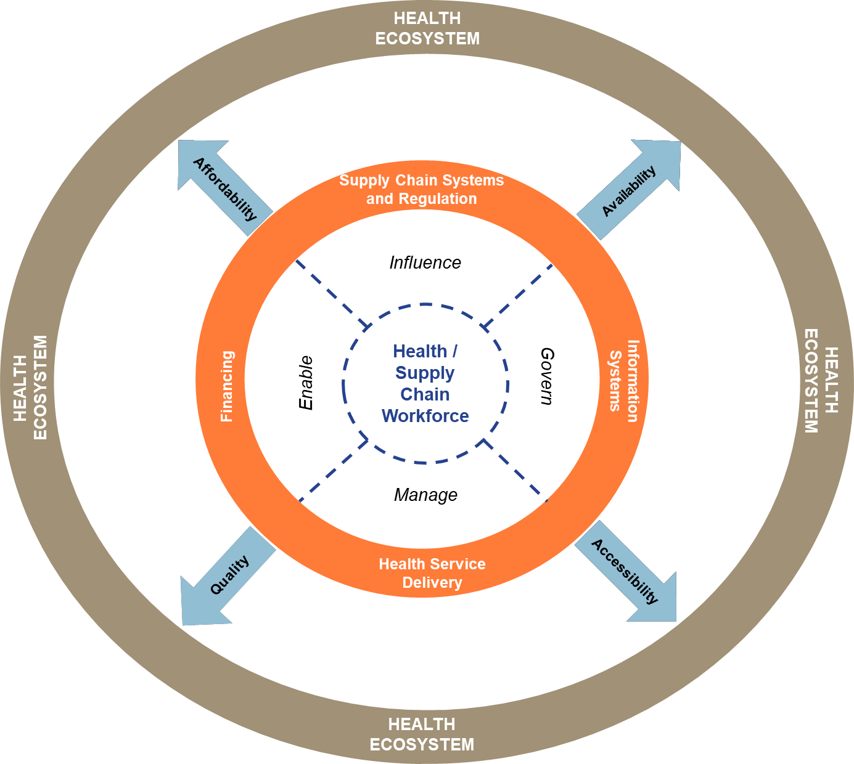
Why Governance & Workforce Development Framework?
Human resources working in health or supply chain are at the centre of the Health Ecosystem where they Manage, Govern, Influence and Enable functioning of systems required to improve Access to Essential Medicines by the community.
Hence, improvements required in these systems (such as supply chains, information systems, service delivery, regulation or financing) first requires strengthening the human resources component.
The G&WD framework provides a holistic approach towards developing organizational and human capacities while navigating the complexities within the system, for sustainable health outcomes.
Notes:
To understand why Governance & Workforce Development framework is required for TGF’s Supply Chain team, we need to first understand and recognize the importance of Human Resources – in this case Health Workforce or Supply Chain workforce working in the countries in the public sector.
There are several studies or frameworks (for example – WHO’s Health System Building Blocks), which has emphasized the role of workforce and how this element of health system sits in the centre where it influences, enables, governs and manages all other systems / building blocks like Supply Chain, Pharmaceutical regulation, Health Service Delivery, Financing etc. An improved workforce subsequently means improved processes across these functions which then eventually leads to Access to Essential Medicines in ending epidemics – which in turn in TGF’s purpose.
Hence, developing the health workforce capacity and capability requires a holistic and comprehensive approach (beyond just training), in order to improve Supply Chains. Hence, a Governance & Workforce Development framework can become an important tool for the Supply Chain Team of TGF while identifying and designing investments in this area.

Slide 10
Why Governance & Workforce Development Framework?
The Governance and Workforce Development framework supports TGF’s supply chain team in identifying various governance and workforce development investments that can be applicable at country level
(even beyond the ones listed in SCR and PSM-SI)
Rationale for Governance & Workforce Development Framework
The G&WD framework supports TGF’s supply chain team in identifying a logical pathway while investing in such initiatives mentioned in SCR and PSM-SI.
Notes:
More specifically, the G&WD framework can help TGF supply chain team understand the wide scope of investments that can be made in this area, even beyond what is already stated in the SCR or PSM-SI. The framework can also hash out the scope of some of investments areas listed in these documents.
Moreover, the framework recommends using a logical pathway to achieve the targets under those investment areas, in order to ensure that initiatives are sustainable, leads to local accountability and stewardship from local leadership – WHICH IS PIVOTAL AS PER LESSONS LEARNT FROM PAST EXPERIENCES!

Slide 11
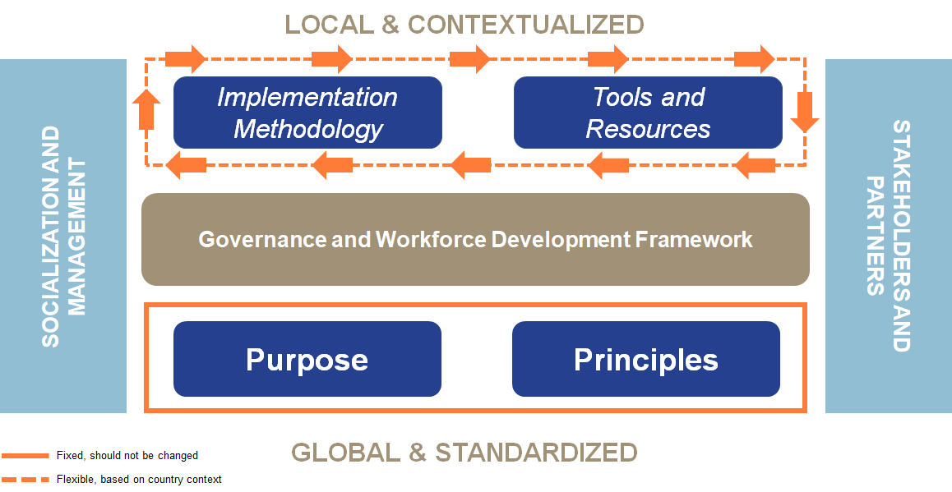
What is Governance & Workforce Development Framework?
Notes:
The Governance and Workforce Development (G&WD) framework is a set of principles and processes supplemented with tools and resources to support TGF staff (SC Specialists, HPM Specialists etc.) approach supply chain transformation from a human resource perspective. The G&WD framework can also be looked at as a Toolkit, designed to sustainably develop Skillsets and shape Mindsets from narrowly focussed training agendas to broader Human Capital Development for Public Health Supply Chain Transformation.
The framework has been developed keeping in mind stringent Principles – which are global and standardized & with minimal scope of modification, which should most always be followed while identifying, designing and implementing the initiatives. This is to make sure that the investments achieves its purpose.
However, when it comes to defining implementation methodologies and tools/resources for implementation of such initiatives, local and contextualized means should be used for better sustainability and accountability. Hence, the framework provides several resources which can contextualized and used when needed in a specific country.
The framework also emphasizes on collaboration and coordination with other partners involved in G&WD activities at a country or global level, to ensure duplications can be avoided and initiatives are streamlined as per Country’s strategic plans.

Slide 12
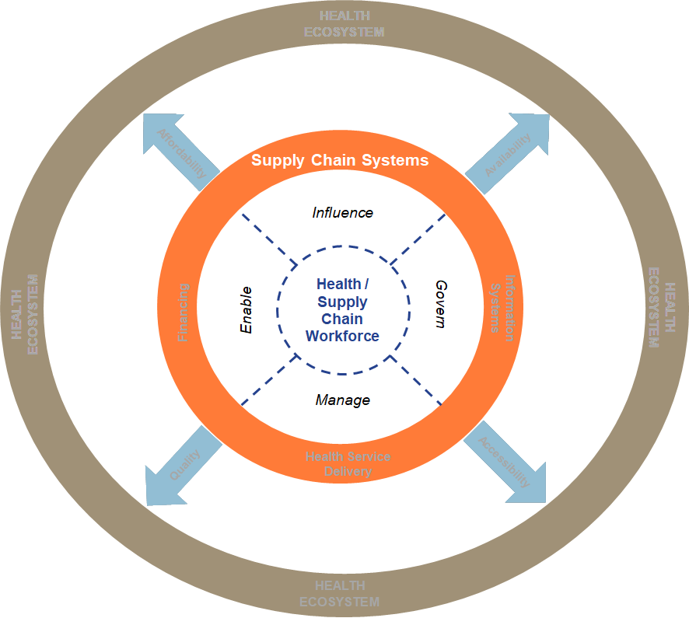
What is Governance & Workforce Development Framework?
National SC Workforce
The Governance and Workforce Development (G&WD) framework is a set of principles and processes supplemented with tools and resources to support TGF staff (SC Specialists, HPM Specialists etc.) approach supply chain transformation from a Human Resource Perspective.
Notes:
The G&WD framework is specifically designed for developing health workforce working in public health supply chains.

Slide 13
Let’s understand how the G&WD framework can support TGF’s supply chain staff in implementing the SCR or PSM-SI.

Slide 14
Investing in Initiatives listed in SCR / PSM SI based on G&WD principles (1/2)
Let’s take a deep dive in understanding how G&WD framework can support TGF officers in adopting a more focussed and holistic approach while designing the investment areas listed in SCR / PSM – SI.
SCR: Thematic Role 3 – Capacity Development
Investment Area
Support organizational design to include adequate SC roles, appropriate recruitment, retention and motivation practices (incl. ongoing capacity development)
There can be various initiatives under this one investment area mentioned in SCR. To identify and understand the initiatives, TGF officers can follow the EDIS/ToC matrix of G&WD framework. In this particular case, the following initiatives listed under EDIS/ToC matrix falls under this investment area.
HR4SCM Diagnostics
Design organizational HR policies package
Workforce planning & estimation across supply chain functions, organization design
Design staff retention strategy linked to learning & performance management
Training strategy and plan in line with professionalization framework implemented in collaboration with all partners
Incentives (financial + non-financial) linked to supply chain performance and learning are designed and implemented
ENGAGE ----- DESIGN ----- IMPLEMENT ----- SUSTAIN
Notes:
In this first example, the slide depicts how the G&WD framework has been used to identify various initiatives that can be invested in response to one of the investment areas mentioned under Thematic Role 3 – Capacity Development in SCR.
These initiatives are written in the EDIS order, where investment can begin from HR4SCM diagnostics, and either based on the results of the diagnostic, or based on national strategic plan, other initiatives can be planned to address the stated investment area.

Slide 15
Investing in Initiatives listed in SCR / PSM SI based on G&WD principles (2/2)
Let’s take a deep dive in understanding how G&WD framework can support TGF officers in adopting a more focussed and holistic approach while designing the investment areas listed in SCR / PSM – SI.
PSM SI: Workstream – Sustainable Governance
Investment Area
Design online SC training programs and integrate within pre-service and in-service training curriculum in national systems
Let’s now look at PSM-SI, and an investment area from Workstream Sustainable Governance. There are several initiatives which should be invested in leading towards national systems of pre and in-service training curriculum.
SC professionalization framework validated in country (including preferred methods, sources of courses etc.)
Competency-based Training Needs Analysis across SC or the organization, and a detailed Training Strategy leading to SC professionalization
Detailed training evaluation framework designed aligned with individual and organisational objectives
Training strategy and plan implemented in collaboration with all partners, include implementing online training programs
Integration of supply chain curriculum in health degree programs (Pre-service curriculum)
Supply Chain workers demonstrate adequate technical and managerial competencies (through regular training)
ENGAGE ----- DESIGN ----- IMPLEMENT ----- SUSTAIN
Notes:
In this second example, the G&WD framework is used to identify initiatives to address the investment area from PSM-SI.
In both cases, a logical pathway has been followed according to the EDIS model, to identify the initiatives.
It is also important to understand that if a logical pathway is not followed to address these investment areas, those initiatives may not be sustainable and may not receive full ownership and accountability from national stakeholders.

Slide 16
It is understood that one investment area listed on SCR or PSM-SI can result in several initiatives, and EDIS/ToC matrix within the G&WD framework can help identify those initiatives.
How else G&WD framework can be applied?

Slide 17
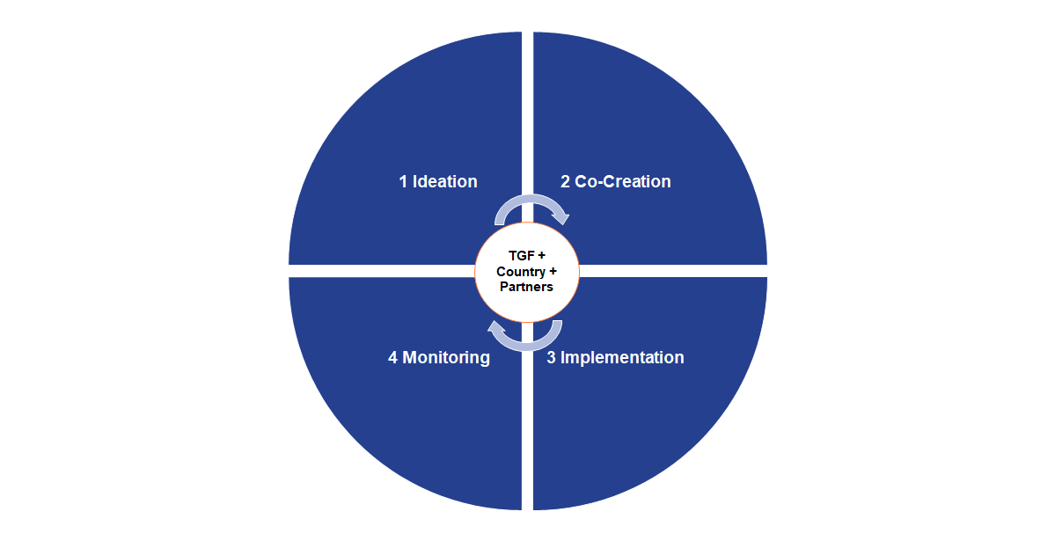
Applying G&WD Framework
1
Identify initiatives that match TGF’s investment areas and national priorities (based on national strategic plans)
Take help of EDIS/ToC matrix to identify initiatives that fits into the country priorities
2
Working with national government, other partners and TGF PRs, design the initiatives based on G&WD principles, while engaging other TGF teams.
Conduct risk analysis and discuss mitigation plans.
Make use of several resources provided as part of G&WD framework during project design
The G&WD framework proposes a stepwise method of engagement and collaboration from ideation and co-creation to implementation and monitoring of governance and workforce development initiatives in-country.
4
Monitor the project implementation and performance of the service provider, using the partnership engagement guide.
Make use of several resources provided as part of G&WD framework during project implementation
3
Contract service providers based on project design, in collaboration with other stakeholders. The G&WD framework proposed standard template for developing Terms of Reference.
For training requirements, the G&WD framework also provides a library of training courses which can be implemented at a country level.
Notes:
This slide depicts how the G&WD framework can be used by TGF supply chain specialists while collaborating with their national counterparts and other partners. Following a 4-step process, initiatives can be designed, implemented and monitored using the tools, templates and resources provided with the framework.

Slide 18
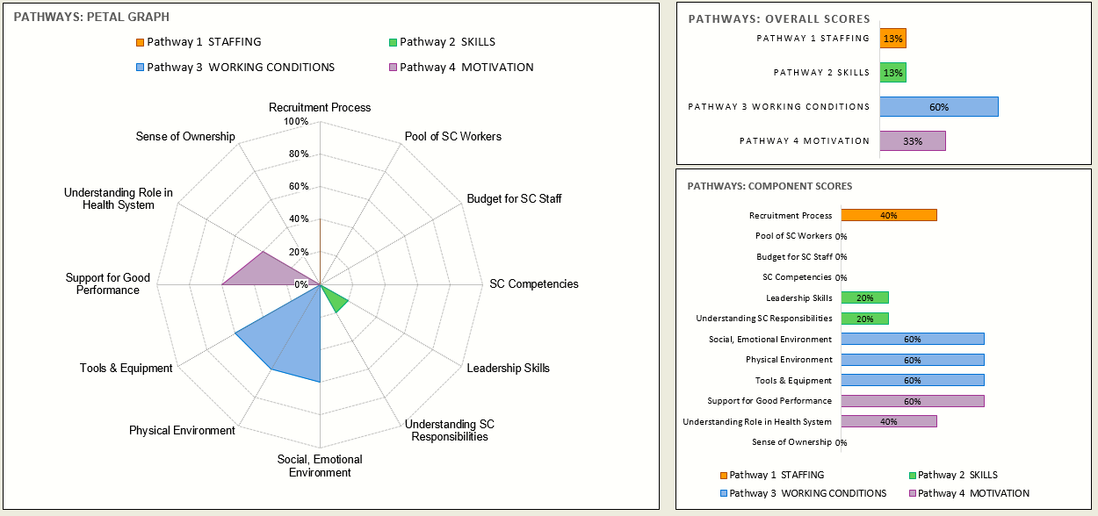
Applying G&WD Framework – Example from TGF investment in Vietnam
Introduction: The Global Fund in collaboration with People that Deliver invested in conducting Human Resources for Supply Chain Diagnostic and a Training Needs Assessment for the national supply chain stakeholders in Vietnam.
Key points: The HR4SCM diagnostics show a need for massive improvement on Staffing, Skills and Motivation, while the country has invested to some extent on Employee working conditions. The analysis also found that Vietnam’s supply chain is currently at an AD HOC stage of maturity where there are no formal procedures for its operation and the supply chain efforts are fragmented across various units or programs in the health sector. A significant number of metrics that are low related to Supply Chain Governance and Human Resources.
The diagnostic also showed that there are no specific HRSCM strategies, plans, positions, job descriptions, competency framework, career paths, systematic continuous in-service training system, or budgets. Hence, there are limited effect of technical supply chain interventions in the country, since risks are unmitigated and systemic root causes are not identified and addressed in the overall health system.
The report recommends the above roadmap for investment in Vietnam to improve its human resources involved in Supply Chain.
The Global Fund can follow the G&WD framework in framing and executing Investments that matches the recommendation here.
Using the EDIS/ToC matrix, initiatives can be selected, and then developed using the Ideation | Co-Creation | Implementation | Monitoring pathway.
*Similar studies conducted in Thailand and Ukraine identified similar issues in Supply Chain and recommendations to strengthen Human Resources in Supply Chain. TGF staff can use the G&WD framework is ideate, co-create, implement and monitor investments with National stakeholders.
Notes:
In showing the application of the 4-step method shown in slide 17, we can take example of TGF’s support to Vietnam. In 2020-21, with TGF’s support, a HR4SCM diagnostic was conducted in Vietnam to understand their human resource governance and capability for health supply chain.
If we follow the EDIS/Toc Matrix from G&WD framework, TGF invested in the Engage phase where key deficiencies were identified paving the way for a comprehensive development of governance system and workforce capability in Vietnam’s health supply chain.
Based on the results, and following the G&WD framework, next steps can be plotted in collaboration with national stakeholders and other partners, which can be invested in by TGF based on their future investment plans.

Slide 19
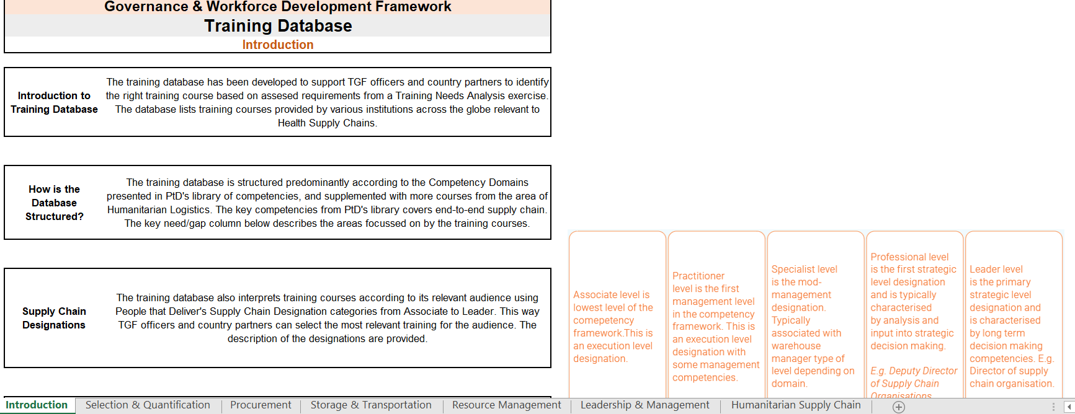
Resources available with G&WD Framework
The G&WD framework also comes with several resources which supports TGF staff in applying the framework while investing in governance and workforce development initiatives.
Resource 1: Implementation Guidance Workbook for Governance & Workforce Development Framework (Excel workbook)
It also includes:
Format for Risk Analysis
G&WD Resources
Resource 2: Scope of Work template to design workforce development projects (Word template)
Resource 3: Logical Workflows to support development of specific workforce development projects as per G&WD framework (Word document)
Resource 4: Library of Training Courses for developing Supply Chain Competencies (Excel workbook)
Resource 5: Advocacy Note on Holistic Workforce Development using G&WD framework

Slide 20
Definitions
Capacity Development | Governance | Workforce Development | Framework
By Capacity Development, we understand any action that aims at developing professional "capacities" and "capabilities" of an individual or an organisation to fulfil (autonomously) their responsibilities. Capacity Development can include a variety of activities in the areas of: Workforce Development (Staffing, Skills, Working Conditions & Motivation) Processes and systems, including information systems Infrastructures | How TGF recipients (e.g., Government Supply Chain Organisations), manage and govern their supply chain operations in the country (including human resource management). | How individual and collective human capital is built and organised to best support in-country supply chain management | A set of rules (principles and policies), processes and tools designed to support diverse stakeholders to address complex issues
In TGF’s latest Supply Chain Roadmap, the thematic area of Capacity Development aims to "Develop in-country SC capacity through professionalization of the supply chain, ensuring process sustainability, providing TA, strengthening last mile delivery and supporting institutional & organizational capacity and capabilities strengthening"

