Slide 1
EXAMPLE Workforce Assessment Validation Workshop

Slide 2
Agenda
Introductions
HR assessment goals, objectives, and processes
Overview of data collection methods
Present and discuss Human Resources for Supply Chain Management Rapid Diagnostic Tool (RDT) and focus group discussion results
Present, discuss and validate recommendations
Group presentations
Next steps
Closing

Slide 3
Introductions

Slide 4
Workshop Objectives
Validate the findings from the RDT
Gather feedback from key stakeholders on the results from Central Medical Stores and healthcare facilities focus groups
Identify priority areas for improvement and next steps

Slide 5
Workforce Assessment Objectives
Diagnose human resource challenges
Benchmark against best practices
Guide capacity development
Inform strategic workforce planning
Identify training and development needs
Strengthen human resource policies and governance
Support organisational transition

Slide 6
Data Collection Methods
Health Facilities
Workforce assessment, supported by People that Deliver, uses a mix of focus group discussions and the RDT and Training Needs Analysis (TNA) to understand gaps and priority interventions in human resources for health supply chain management
Target audiences include Ministries, CMS, and a range of health facilities
Assessment spans 3−14 February with a validation workshop and presentation to CMS
CMS
Mbabane Hospital FGD
CMS SMT focus group discussion
MOH
Siphofaneni Clinic FGD
MOH SMT focus group discussion
CMS FGD 1
CMS FGD 2
Nhlangano Health Center FGD
CMS FGD 3
TNA
KS2 Health Center FGD
Notes:
Shelby to complete

Slide 7
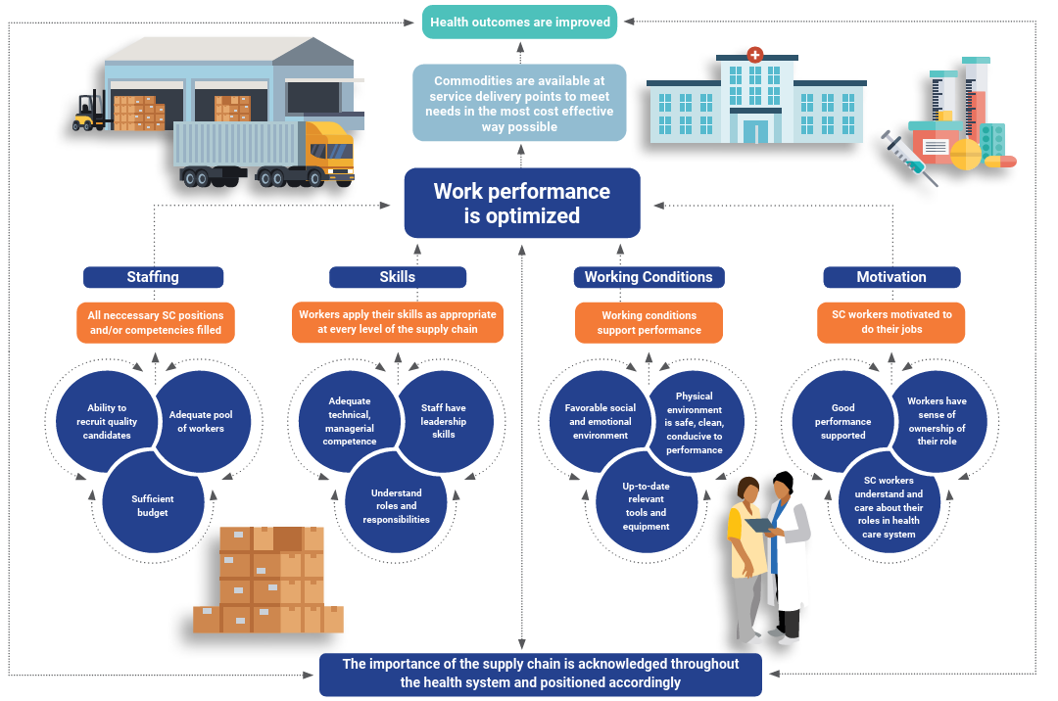
Notes:
The Theory of Change (ToC) presupposes that if four critical supply chain human resource pathways—staffing, skills, working conditions and motivation—are improved, then work performance is optimized, which then contributes to improved commodity availability at service delivery points in the most cost-effective way possible and will ultimately improve overall health outcomes.
The diagram shows the ToC foundational principle with its four pathways.
The HR4SCM ToC describes the steps needed to achieve long-term goals.
It identifies the connections between activities and outcomes across four pathways: staffing, skills, working conditions, and motivation.
This approach helps prioritize workforce interventions that strengthen health supply chains.

Slide 8
Icebreaker
Please stand up and move to the corner of the room with the pathway you think will be highest
Pathway 1: Staffing
Pathway 2: Skills
Pathway 3: Working conditions
Pathway 4: Motivation

Slide 9
Overview of Results

Slide 10
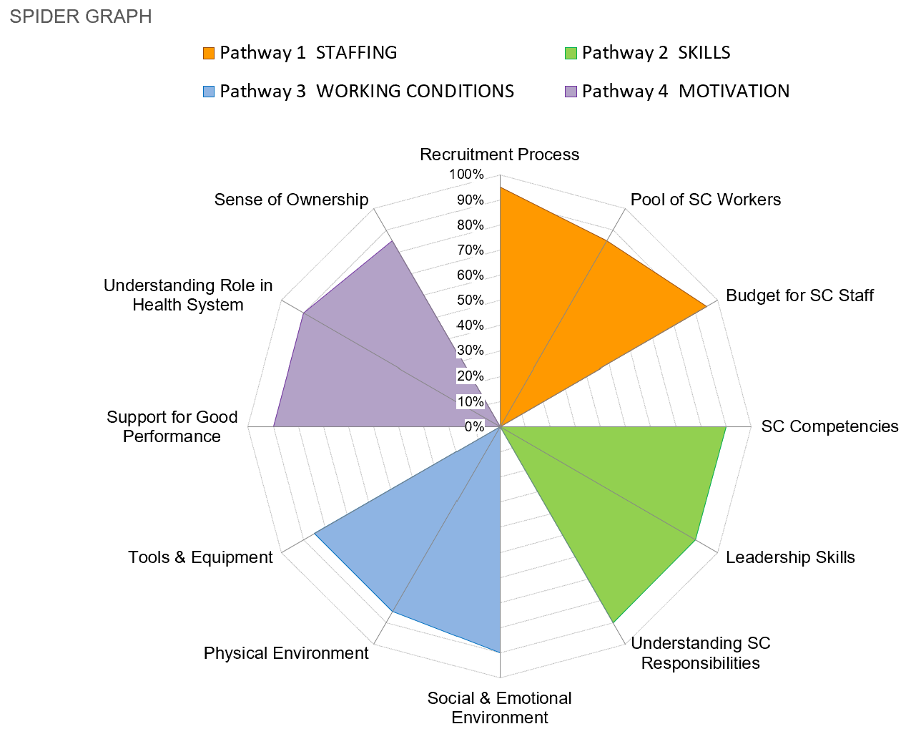
Ideal Spider Graph

Slide 11
Aggregated CMS Spider Graph
The spiderweb indicates the percentage of the pathway that has been met; thus, the size of the petal indicates overall success in that specific pathway.

Slide 12
Pathway Scores
80% and less is regarded as needing improvement

Slide 13
Sub-Pathway Scores

Slide 14
CMS Strengths and Challenges
Strengths
Challenges

Slide 15
CMS Key Takeaways

Slide 16
Insights from Health Facilities

Slide 17
Common Themes

Slide 18
Common Themes

Slide 19
Discussion
Are the findings accurate and reflective of the current situation?
Are there any missing or mispresented insights?
Are there any challenges or contextual factors that may have influenced the results?

Slide 20
Recommendations

Slide 21
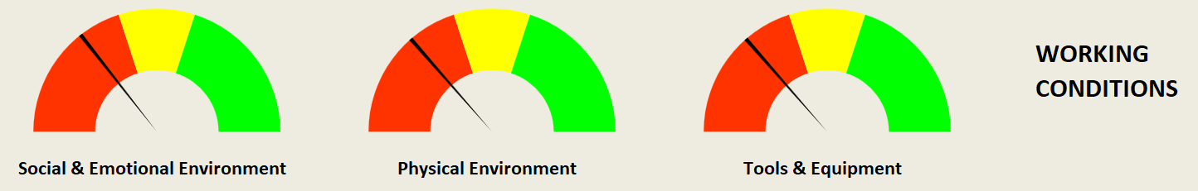
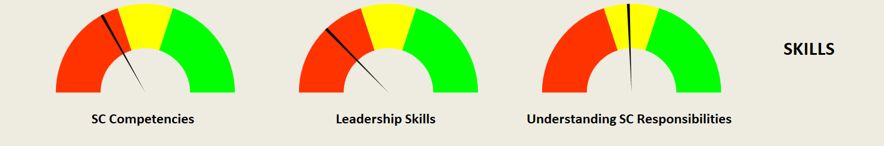

Prioritized workforce development interventions
Notes:
Key findings: Deficiencies in policies (e.g., EEO, harassment), lack of safety protocols, and insufficient resources.

Slide 22
Pathway 3: Working Conditions
Working conditions diagnostic focused on three key preconditions:
Social and emotional environment
Physical environment
Access to tools and equipment

Slide 23
Pathway 2: Skills
Skills diagnostic focused on three key preconditions:
SC competencies
Leadership skills
Role understanding

Slide 24
Pathway 1: Staffing
Staffing diagnostic focused on three key preconditions:
Ability to recruit quality candidates
Maintaining an adequate pool of workers to fill supply chain roles
Securing sufficient budget to fund required positions

Slide 25
Top 15 Recommendations
Priority | Short Description |  | Relative Score
1 | Conduct workplace solution-focused leadership coaching |  | 100%
2 | Train supervisors in workplace policy enforcement |  | 93%
3 | Improve mentoring programs to address competency gaps |  | 88%
4 | Train supervisors in workplace policy awareness |  | 87%
5 | Improve coaching programs to address skill gaps |  | 82%
6 | Develop a review process for job descriptions |  | 81%
7 | Familiarize staff with anti-discrimination policies |  | 80%
8 | Replace missing or defective tools and equipment |  | 80%
9 | Develop SC-specific certificate and degree programs |  | 76%
10 | Publish job advertisements in the appropriate forums |  | 75%
11 | Develop policies to address anti-discrimination |  | 73%
12 | Ensure all tools and equipment are in good condition |  | 73%
13 | Include pharmaceutics in existing SC degree programs |  | 70%
14 | Develop professional job descriptions for all SC positions |  | 70%
15 | Promote the SC in certificate and degree programs |  | 70%

Slide 26
1. Conduct workplace solution-focused leadership coaching
What? Provides coaching to departmental managers using a solution-focused approach. Emphasizes finding practical and actionable solutions rather than dwelling on problems or obstacles.
Why? Used to improve leadership effectiveness, boost team performance, and create a positive work culture.
Goal-Oriented – Helps leaders define clear and achievable goals.
Strength-Based – Focuses on existing skills, resources, and successes rather than weaknesses.
Future-Focused – Encourages forward-thinking and actionable steps rather than analyzing past failures.
Empowering – Supports leaders in making decisions and taking responsibility for solutions.
Efficient – Tends to be time-effective, focusing on quick progress and real-world application.
What it looks like in practice: A coach works with a leader to identify what’s working and build on those successes. The coaching sessions emphasize small, realistic steps toward improvement. Instead of analyzing why problems exist, the focus is on how to fix them effectively.

Slide 27
2. Train supervisors in workplace policy enforcement
What? Provide supervisors with the knowledge, skills, and tools they need to effectively implement and uphold workplace policies
Why? To ensure policies are followed and action is taken.
Topics to include in supervisor training:
Anti-discrimination and harassment policies
Attendance and leave policies
Workplace safety and health regulations
Performance management and disciplinary procedures
Handling employee complaints

Slide 28
3. Improve mentoring programs to address competency gaps
Note: Mentoring focuses on career development in the future (coaching focuses on improving performance in the present)
What? Enhance mentoring initiatives by introducing formal mentoring guidelines and training mentors to ensure they are effective in guiding mentees.
Why? To help employees develop the specific skills and knowledge they lack in order to perform their roles effectively.
Activities
Identifying Competency Gaps: Assessing employees' skills and knowledge to determine areas for improvement.
Tailoring Mentorship Plans: Matching employees with mentors based on their development needs.
Structured Learning: Creating clear goals, milestones, and training activities within the mentorship.
Regular Check-Ins & Feedback: Ensuring ongoing communication to track progress and adjust learning plans as needed.

Slide 29
4. Train supervisors in workplace policy awareness
What? Similar to #2, to provide supervisors with the knowledge, skills, and tools on workplace policy awareness
Why? To educate employees on workplace policies.
Activities
Conducting training sessions on company policies.
Distributing employee handbooks and policy documents.
Ensuring employees acknowledge policies through signed agreements.

Slide 30
5. Improve coaching programs to address skill gaps
Note: Coaching focuses on improving performance in the present (mentoring focuses on career development in the future)
What? Introducing the concept of coaching to diversify learning and providing ongoing capacity development rather than one-time training
Why? To help employees develop the specific skills they need to perform their jobs more effectively
Activities
Identify skills gaps: Assess employees’ strengths and weaknesses to determine areas for improvement.
Create personalized development plans tailored to individual or team needs.
Train coaches
Implement structured check-ins and performance reviews to track progress.
Encouraging a Growth Mindset: Fostering a learning culture where employees feel empowered to improve.

Slide 31
6. Develop a review process for job descriptions
What? Develop a review process for job descriptions" by creating a structured method to regularly assess, update, and refine job descriptions
Why? To ensure they remain accurate, relevant, and aligned with CMS needs. It also ensures clarity and accuracy of roles and helps with recruitment and performance evaluations.
Key Steps
Establish Review Criteria: Define what aspects of the job description need to be evaluated (e.g., job duties, required skills, qualifications).
Set a Review Schedule: Determine how often job descriptions should be reviewed (e.g., annually, biannually, or when business needs change).
Involve Key Stakeholders: Engage HR, department managers, and employees in the review process to ensure accuracy.
Incorporate Employee Feedback: Gather input from employees currently in the roles to identify outdated or missing responsibilities.

Slide 32
Discussion
What are the most critical areas that require action?
Please review the priorities and reflect on the following:
Relevance
Feasibility
Affordability
Time-bound
External support

Slide 33
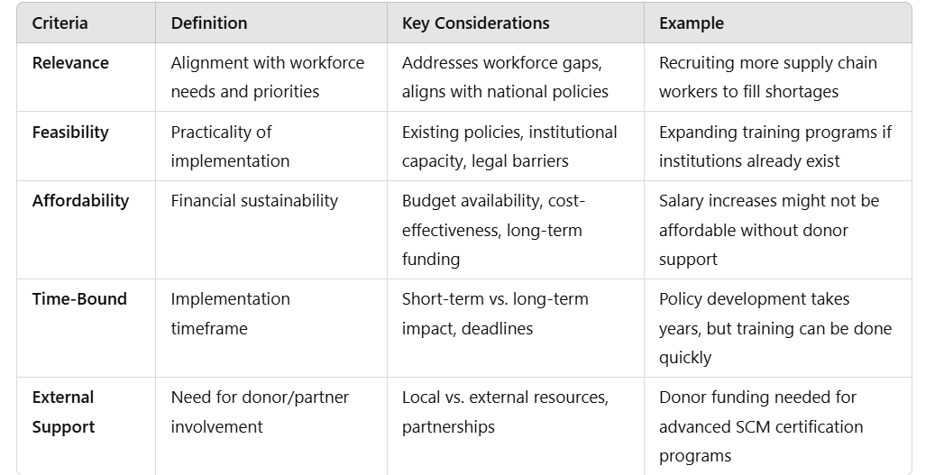
Prioritization

Slide 34
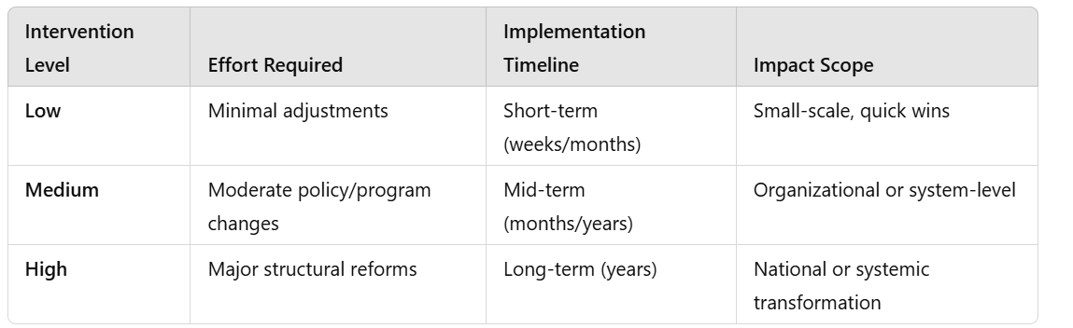
Intervention Level

Slide 35
Questions
Relevance
Does this intervention address a critical workforce gap in supply chain management?
Is it aligned with national policies and supply chain strategies?
Will it have a significant impact on supply chain performance?
Feasibility
Can this intervention be realistically implemented with available resources and expertise?
Are there existing policies or systems that support or hinder implementation?
Are there legal, institutional, or bureaucratic barriers to consider?
Affordability
Can the intervention be funded within existing budgets or will additional resources be needed?
Are there cost-effective alternatives?
Can the intervention be sustained financially in the long run?
Time-Bound
How long will it take to implement this intervention?
Will it produce short-term or long-term results?
Are there deadlines or milestones that need to be met?
External Support
Can this intervention be implemented using local resources, or is external funding and expertise required?
What role can development partners, NGOs, or donors play in supporting this intervention?
Is there an existing partnership or funding mechanism that can be leveraged?

Slide 36
Group Presentations

Slide 37
Next Steps
Training Needs Analysis with CMS staff In-depth analysis of RDT, TNA, and health facility focus group discussions
Draft report for key stakeholders with prioritized recommendations
Draft targeted implementation plan
Draft change management plan

